Slide 1
Paper Presentation on
“Lemmatization Algorithm Development for Bangla Natural Language Processing”
Paper Link: https://ieeexplore.ieee.org/document/9306652
Group No - 14
Robin Molla ( 17201010 )
Alfi Mashab Mostak ( 19101045 )
Shadab Iqbal ( 19101072 )
Notes:
Assalamu Alaikum, we are group 14 and I am Robin Mollah. In this presentation, we are going to present a paper based on a very important preprocessing task, Lemmatization.

Slide 2
Bangla NLP
What is Lemmatization
Why lemmatization in Bangla NLP
Difference with stemming
Notes:
Lemmatization is a process of extracting base word considering the context. For example: আমি নরসিংদীতে থাকি। Here, the word নরসিংদীতে contains a suffix তে। It is one kind of preposition. If we don’t complete this lemmatization preprocessing, then in later NLP tasks, we will face issues. Suppose, if we do Named Entity Recognition, ণরসিংদীতে will not be identified as a place, as it contains the Prefix তে and NER doesn’t know it is a prefix. Why it’s challenging in Bangla. Because in Bangla, words get changed depending on all most grammatical rules. It is affected by tense, prepositions, parts of speech etc.

Slide 3
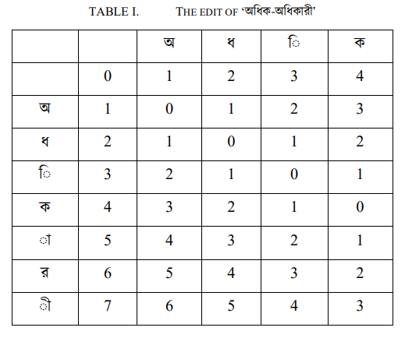
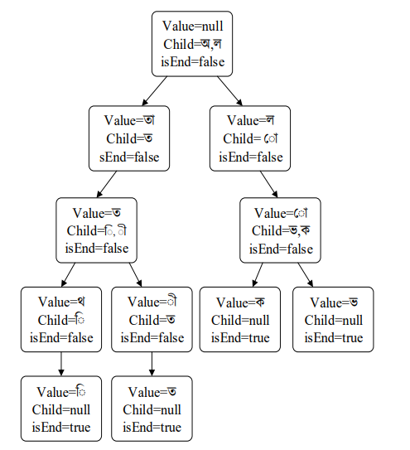
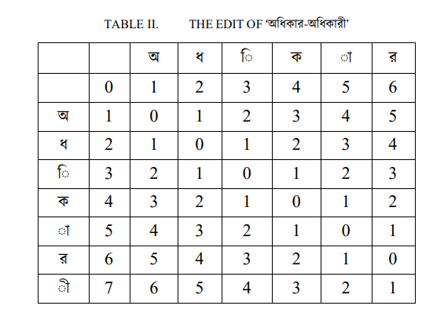
3 Techniques of Lemmatization
And FrameWork
Levenshtein Distance
Trie

Slide 4
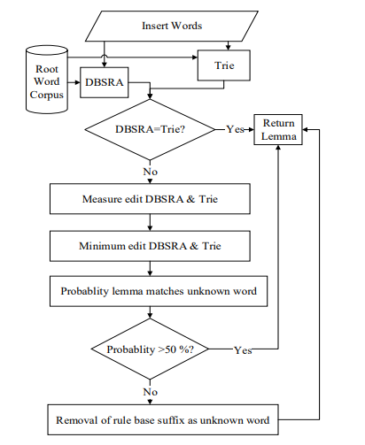
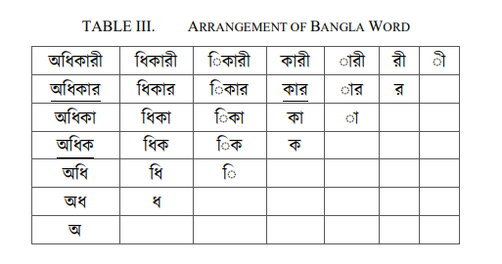
DBSRA
Bangla Lemmatization Framework

Slide 5
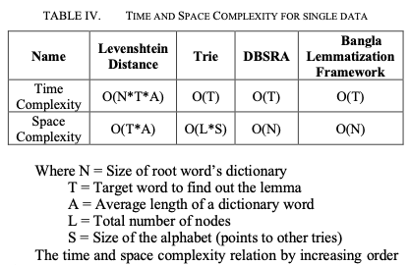
Testing Data
67 articles were collected from “The Daily Prothom Alo”
Contained white-space and punctuation separated 17, 848 words
After cleaning and removing stop words the number was reduced to 16,132
Model Performance
Performance based on
- Accuracy
- Space Complexity
- Time Complexity

Slide 6
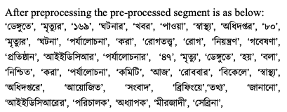
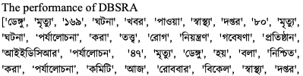

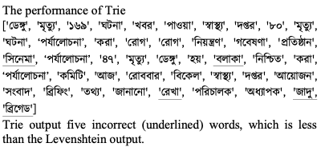
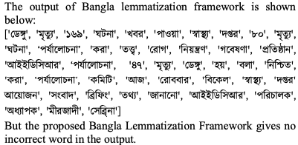
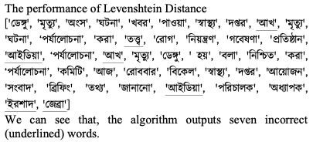
Experimental Results

Slide 7
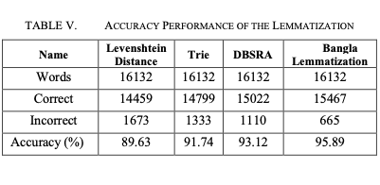
Experimental Results

